Slide 1
影像處理 Chapter 05頻率域影像處理
Chien-Chang Chen
Tamkang University
Department of Computer Science and Information Engineering

Slide 2
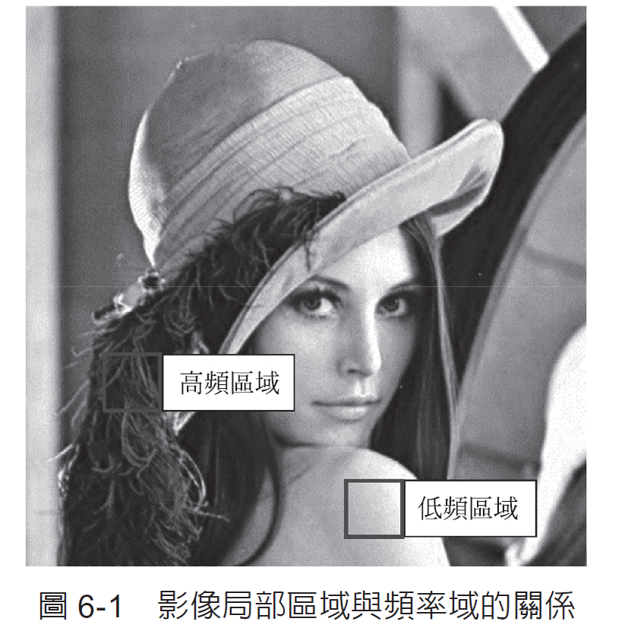
基本概念

Slide 3
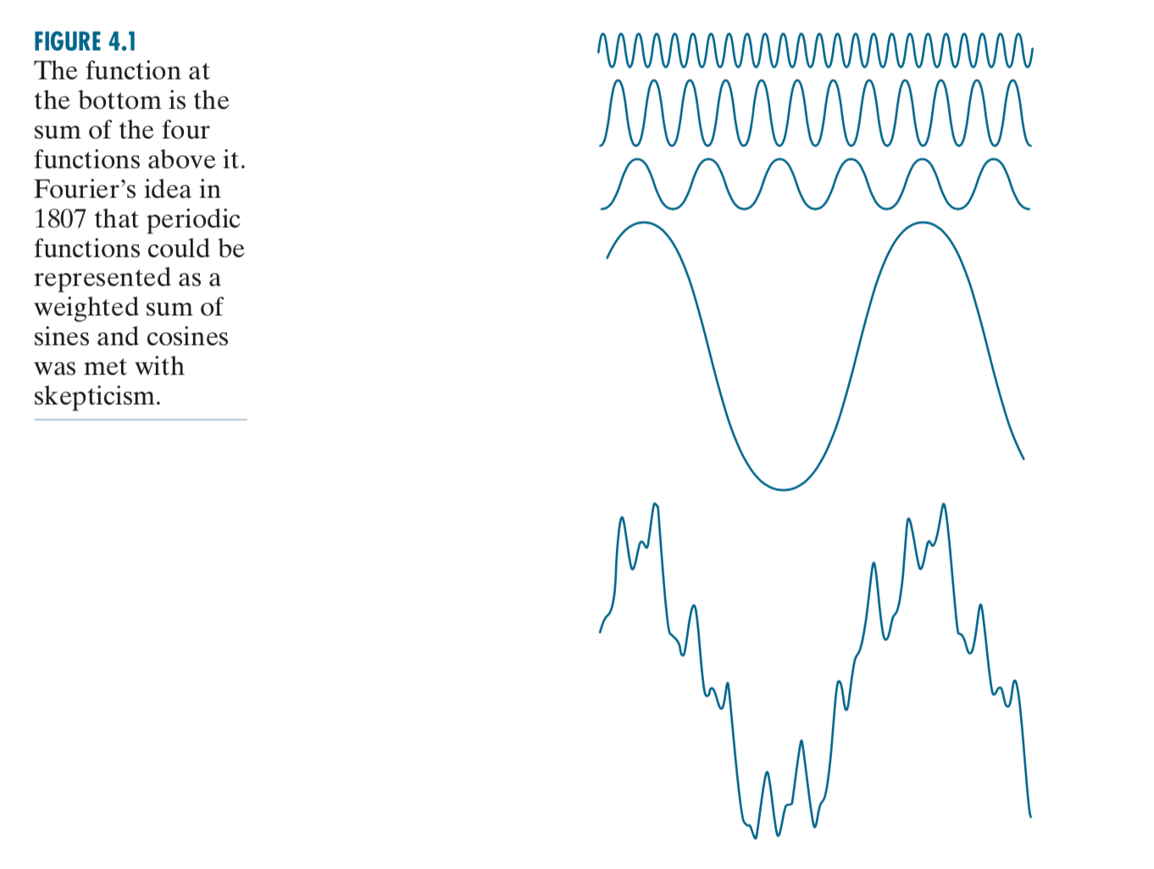
Fourier Series

Slide 4
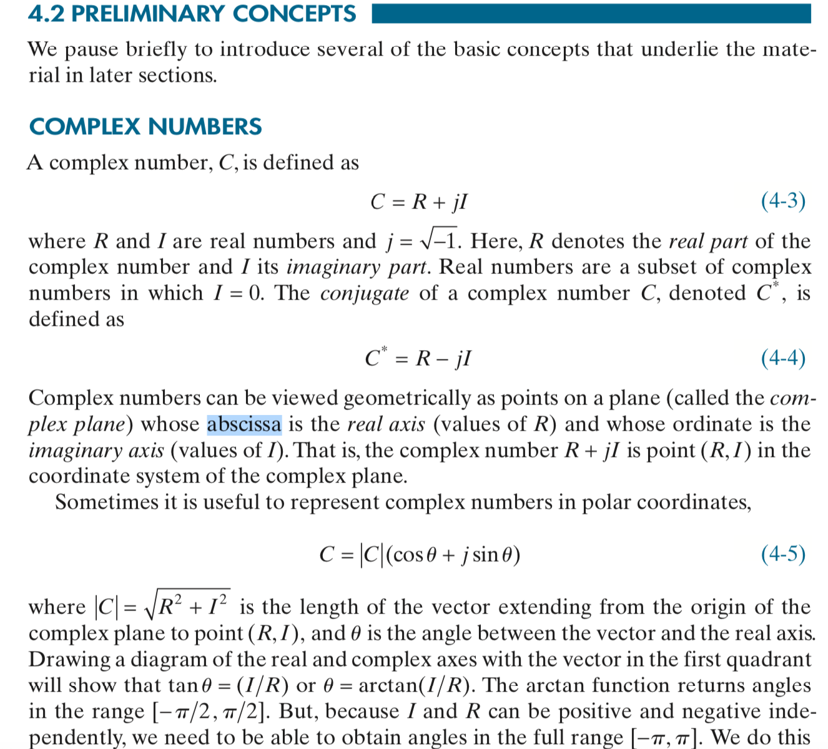

Slide 5
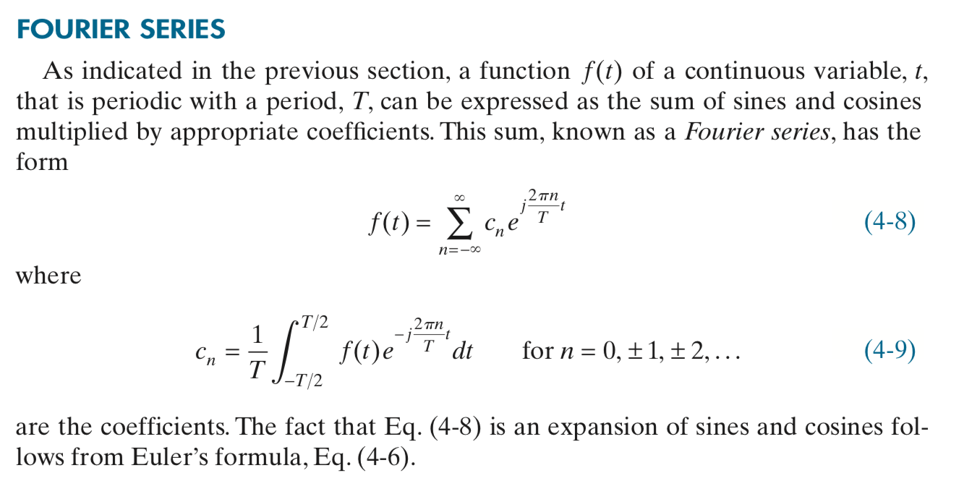

Slide 6
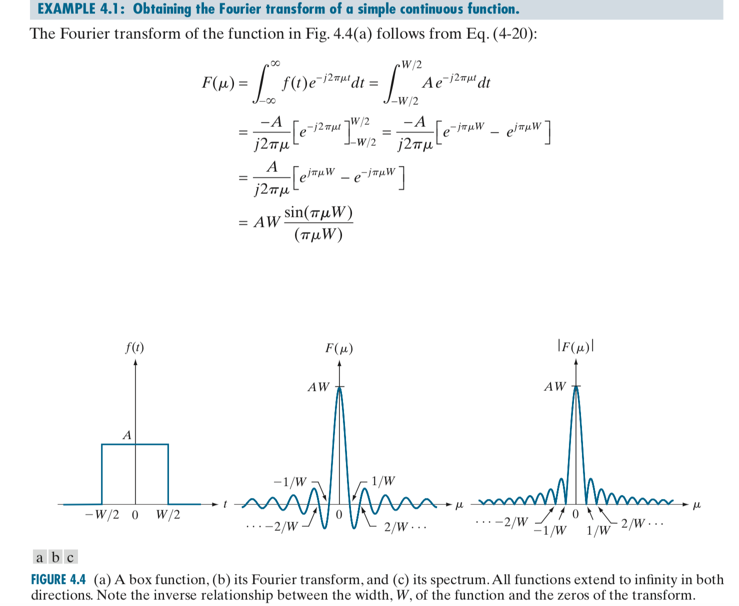
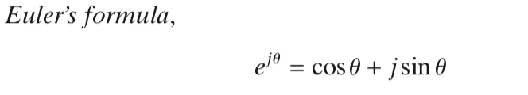
練習計算

Slide 8
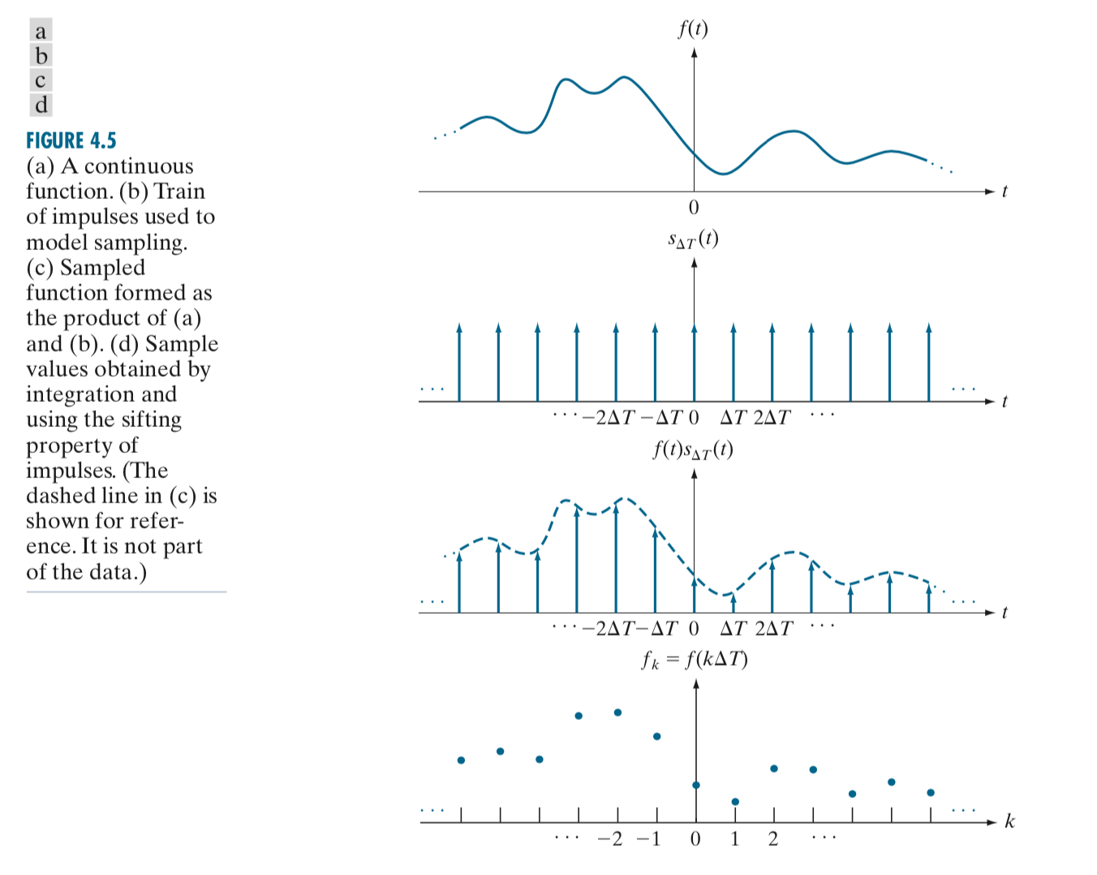

Slide 9
檢視 5.1 FFT Sample 程式

Slide 10
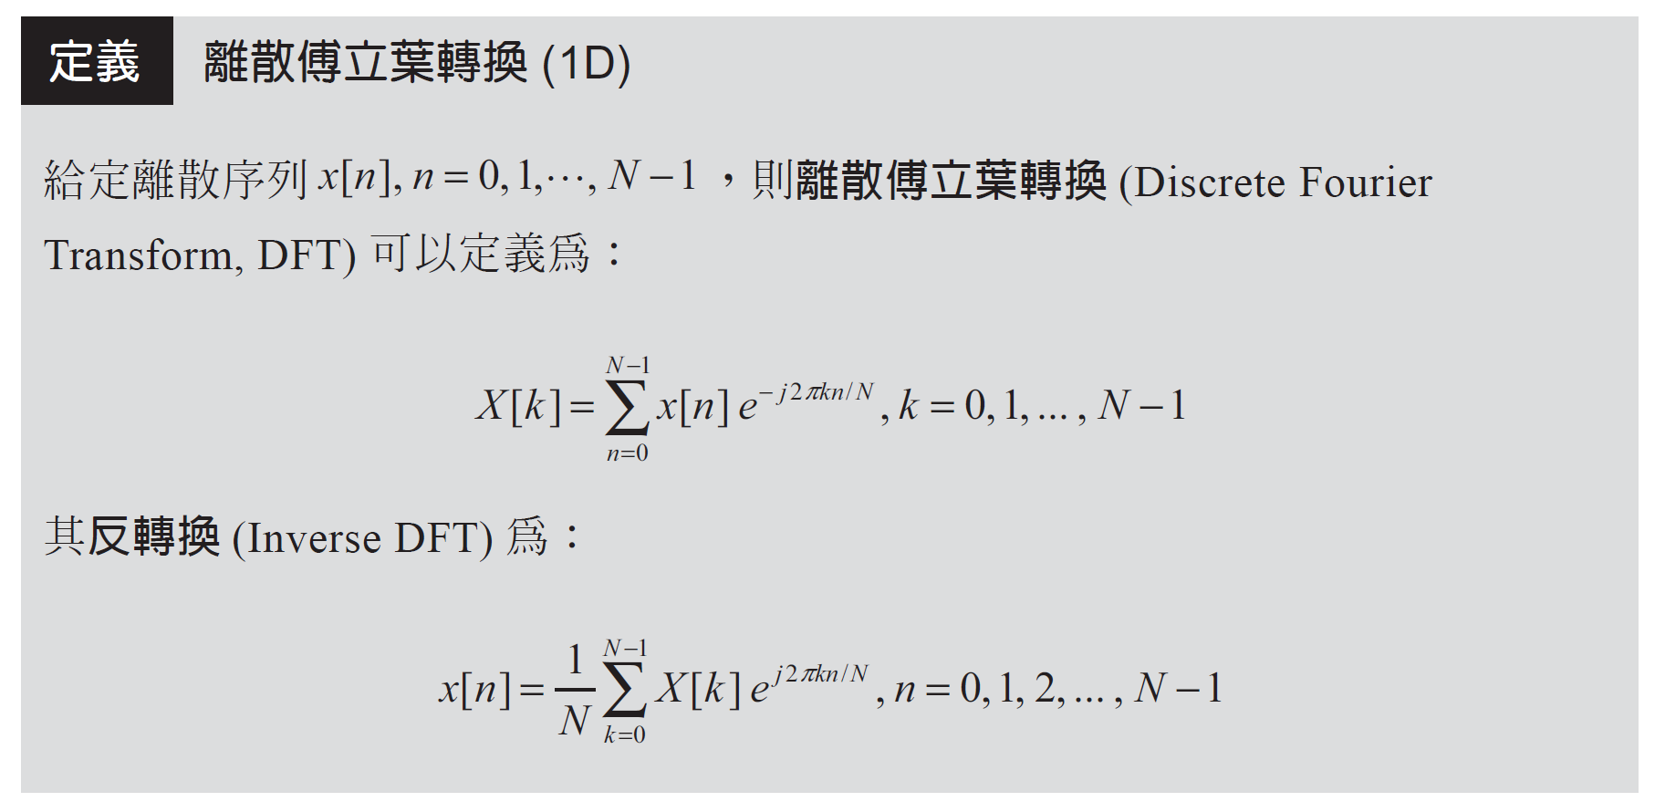
6-2 離散傅立葉轉換

Slide 11
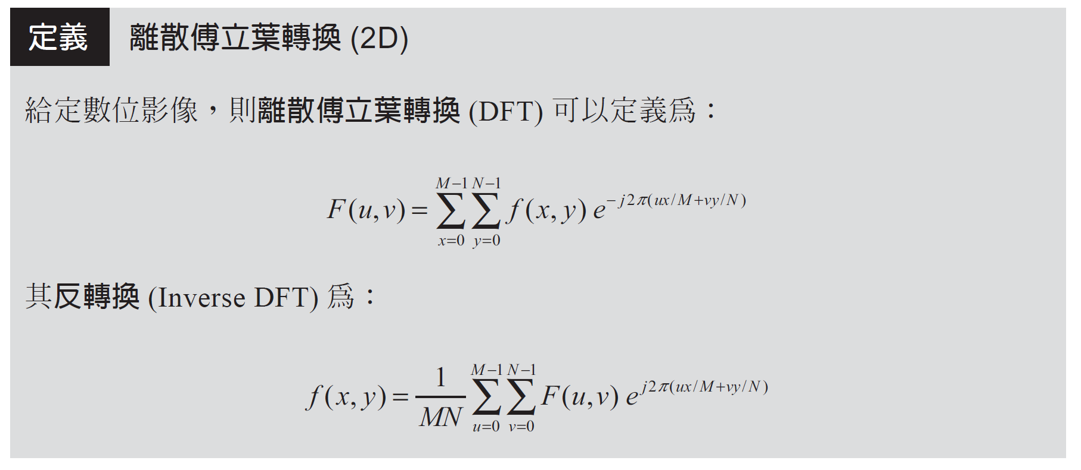

Slide 12
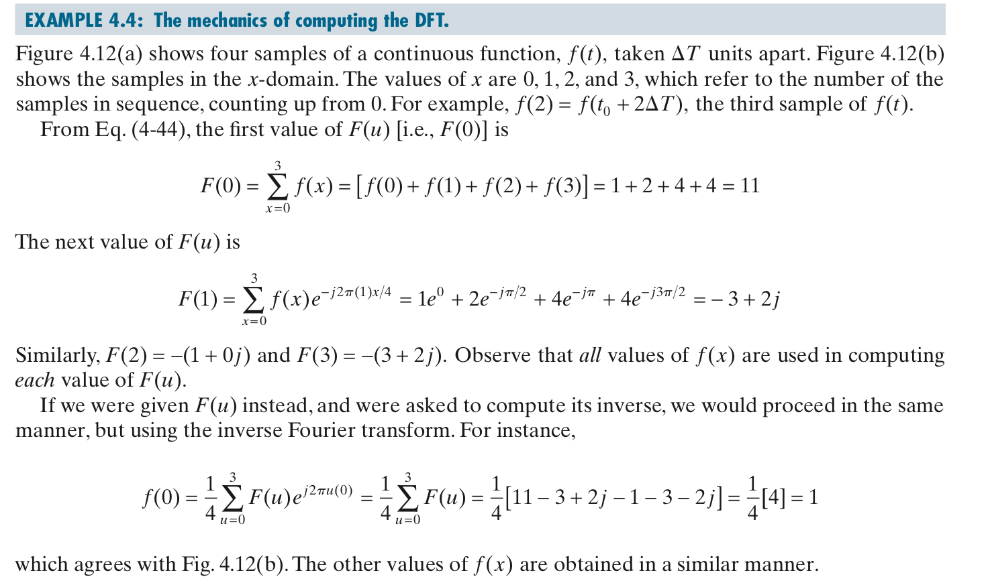

Slide 13
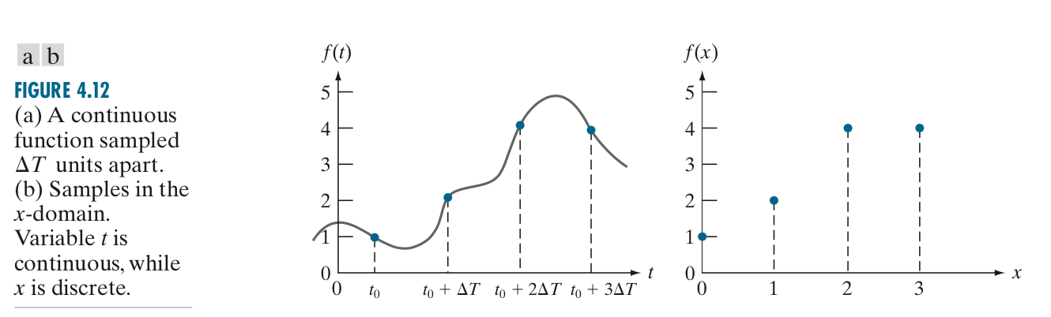

Slide 14
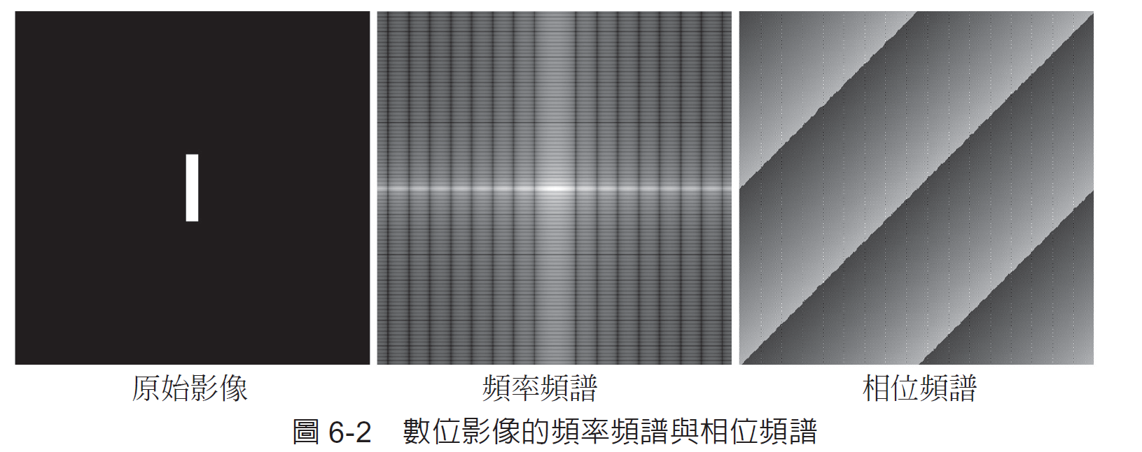

Slide 15
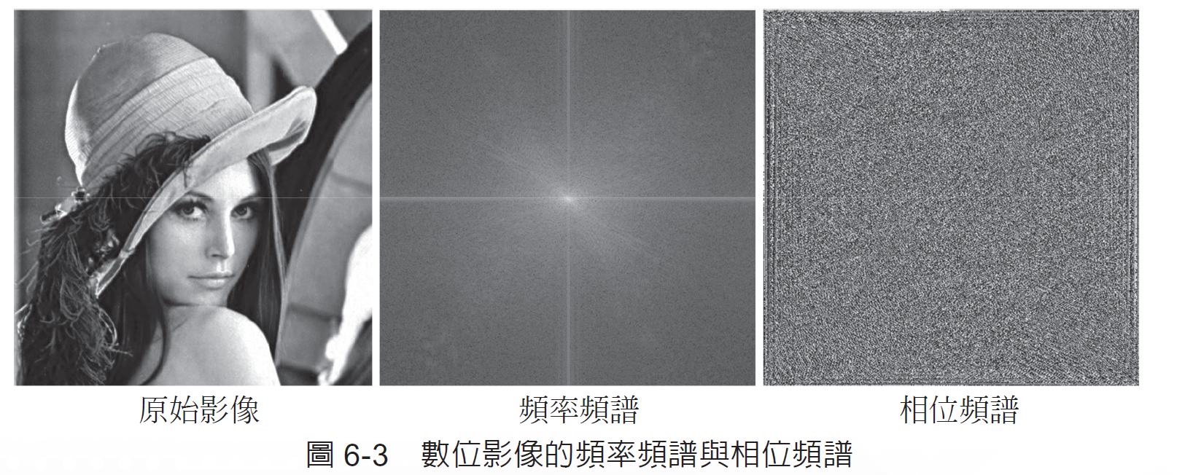

Slide 16
檢視 5.2 Fourier Spectrum 程式

Slide 17
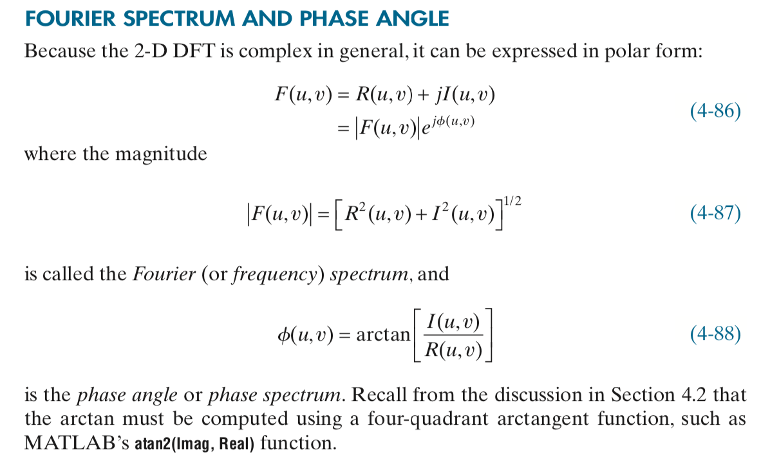

Slide 18
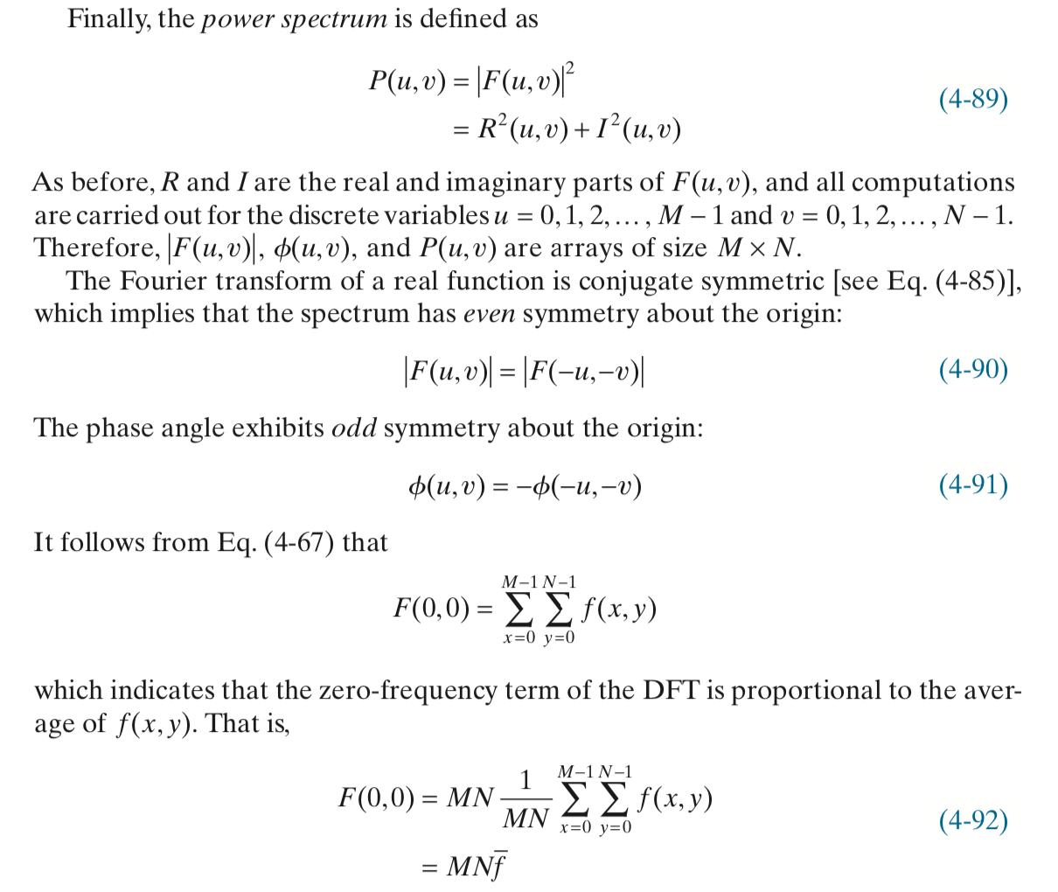

Slide 19
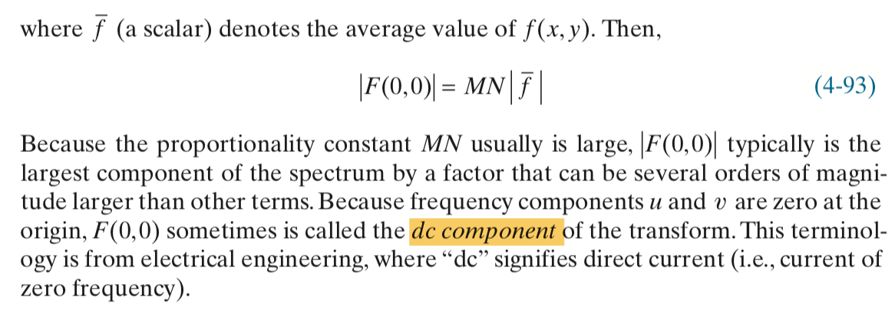

Slide 20
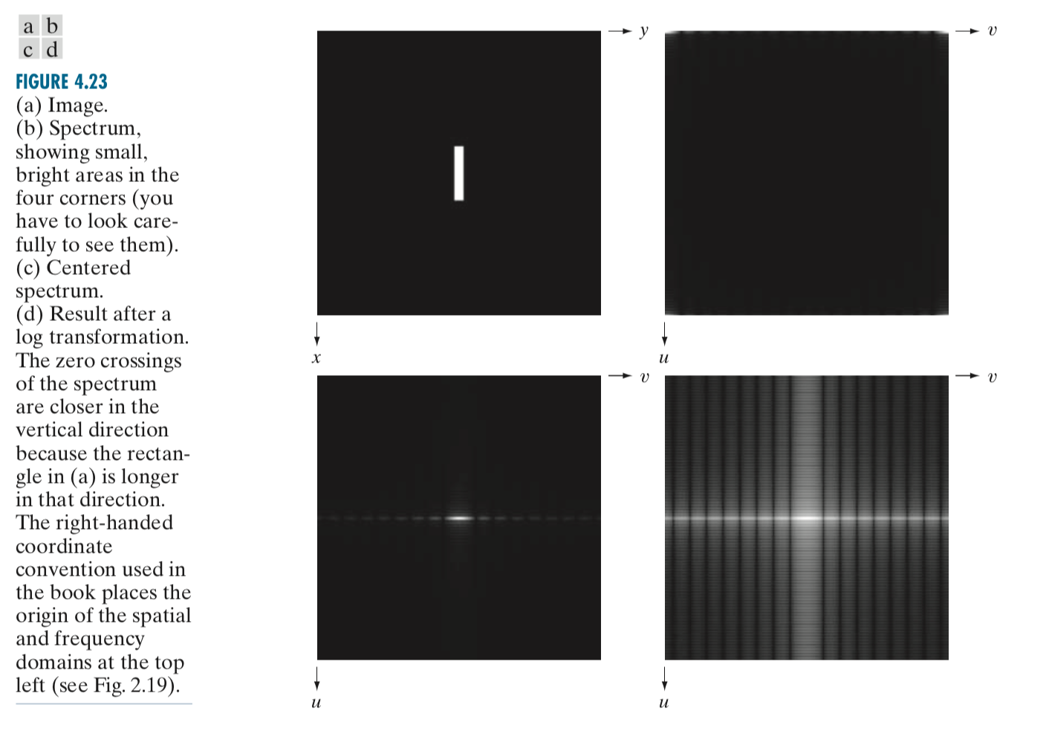

Slide 21
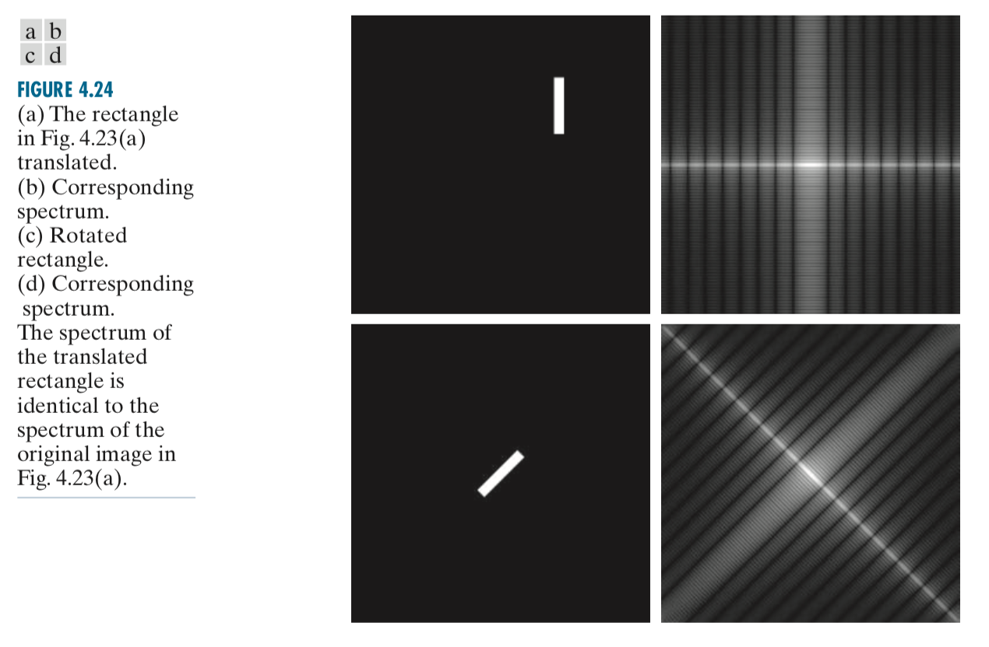

Slide 22
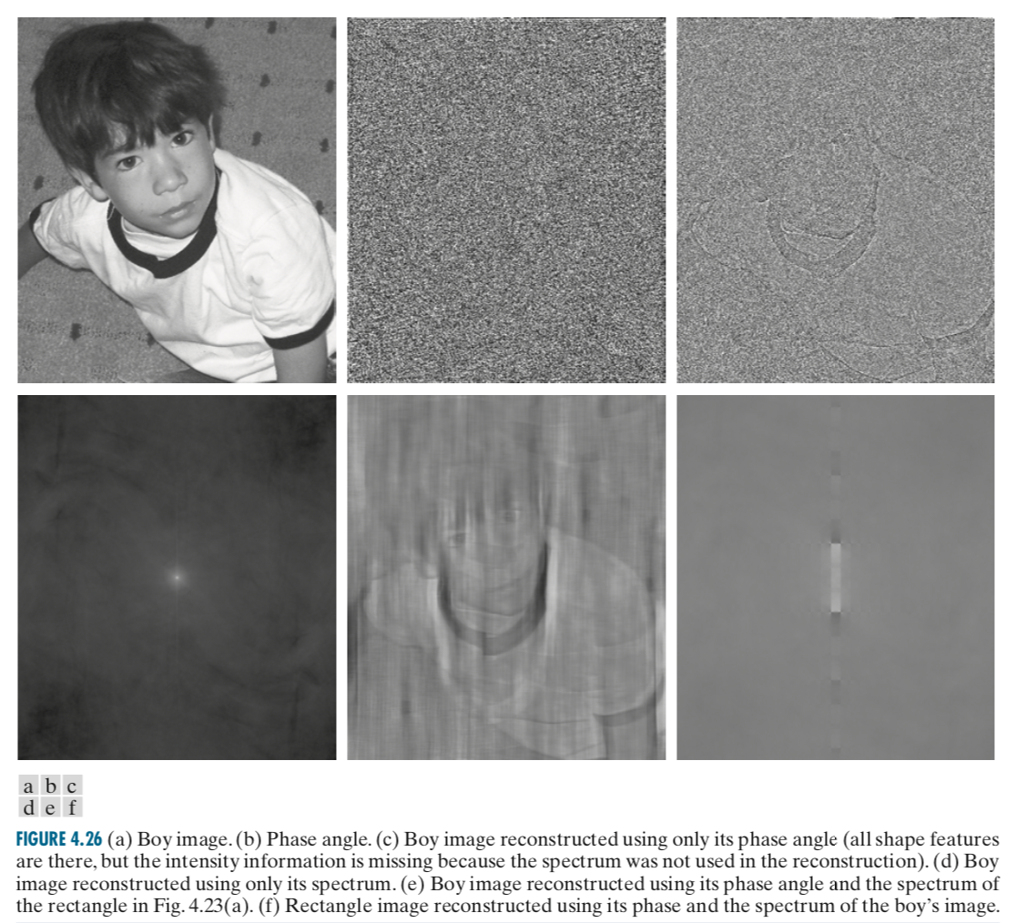

Slide 23
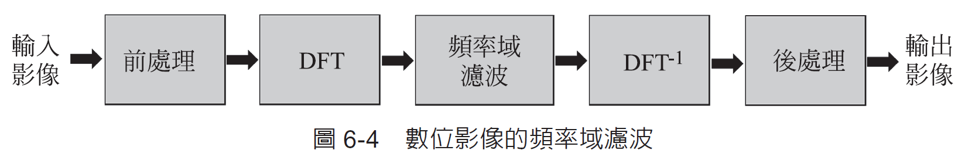
6-3 頻率域濾波
$${(−1)}^{x+y}∙f(x,y)$$
$$G\left(u,v\right)=H(u,v)∙F(u,v)$$

Slide 24
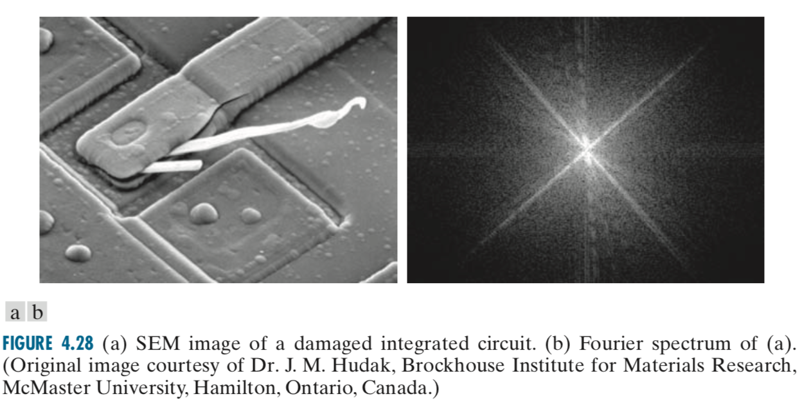
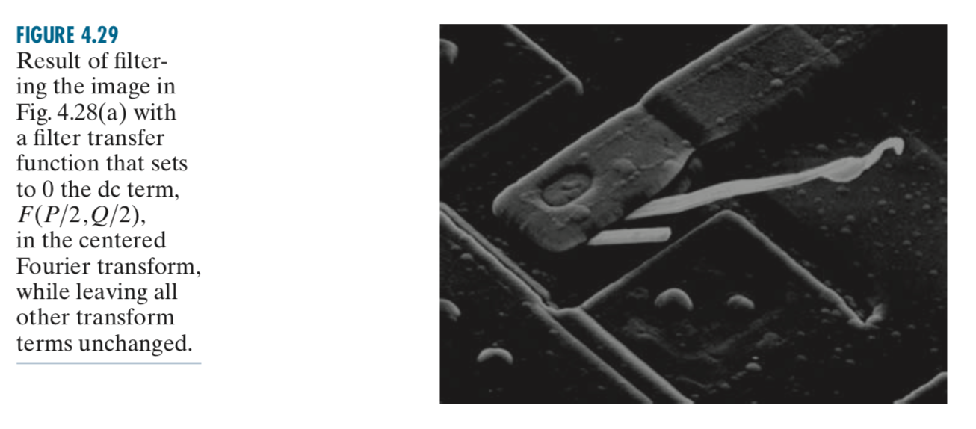

Slide 25
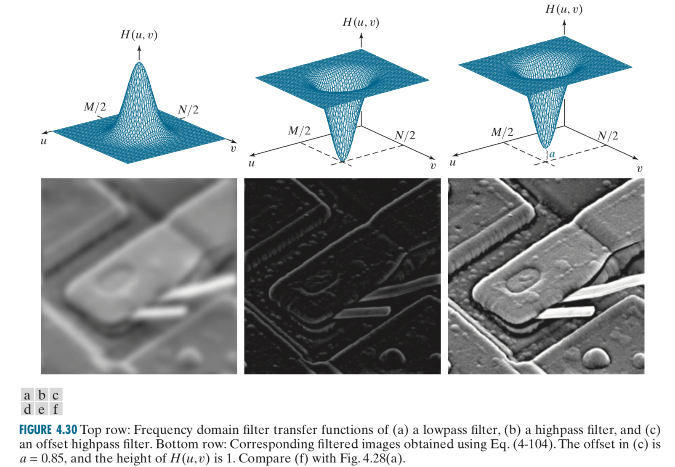

Slide 26
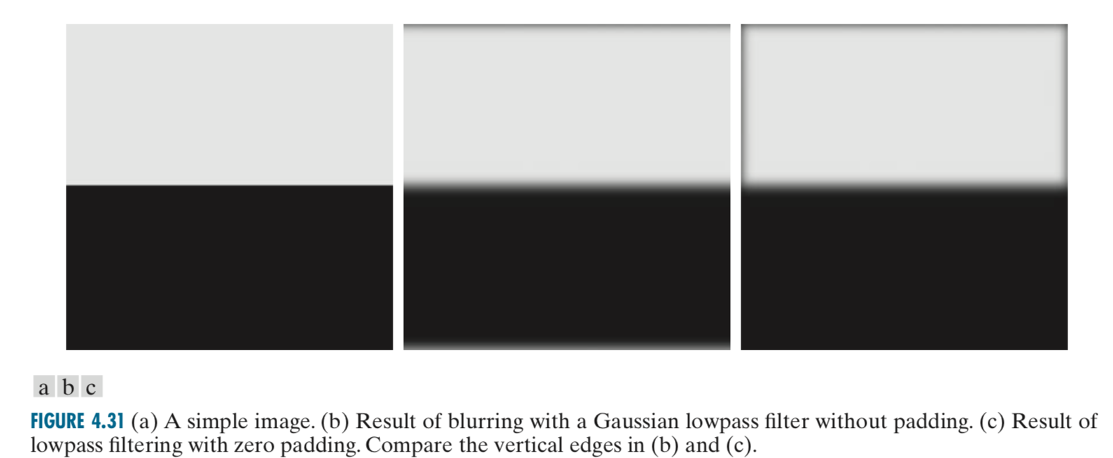

Slide 27
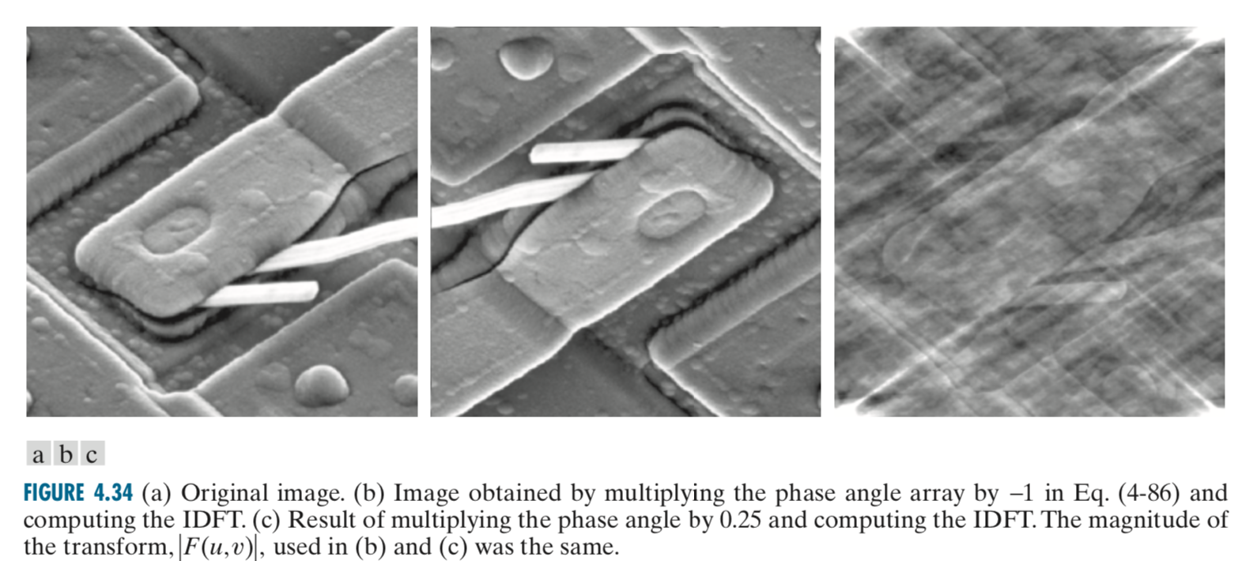

Slide 28
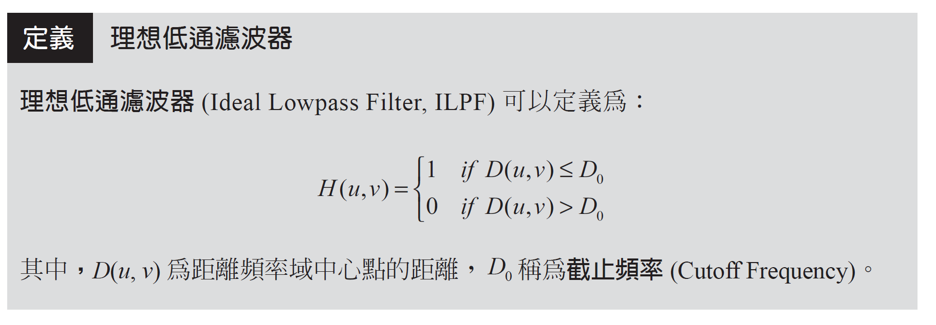
6-3-2 頻率域濾波器

Slide 29
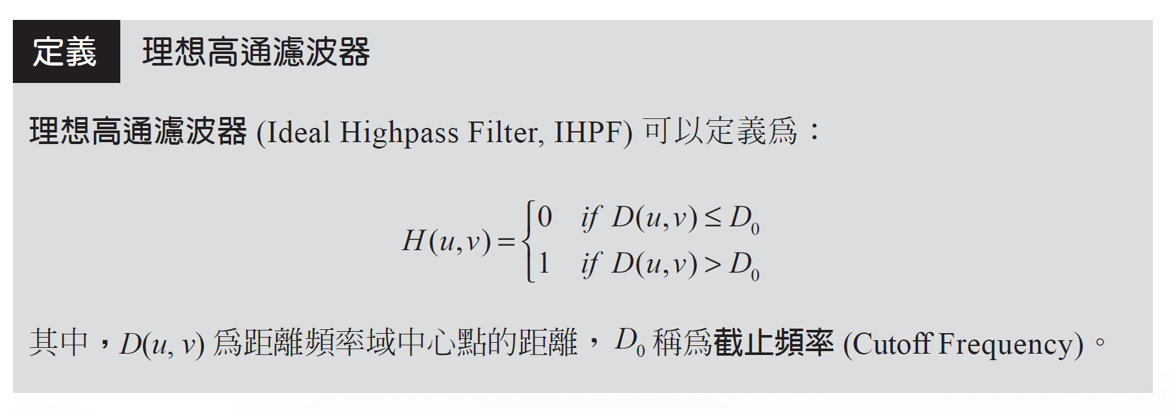

Slide 30
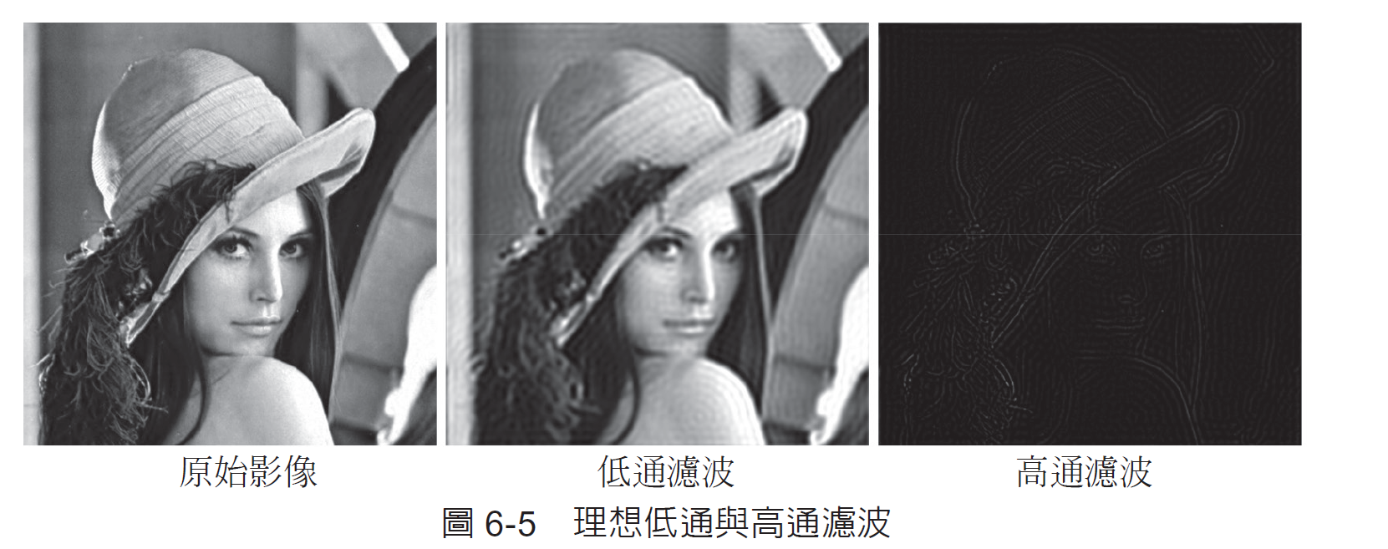

Slide 31
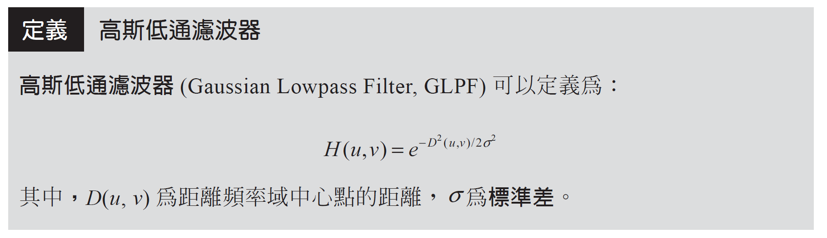

Slide 32
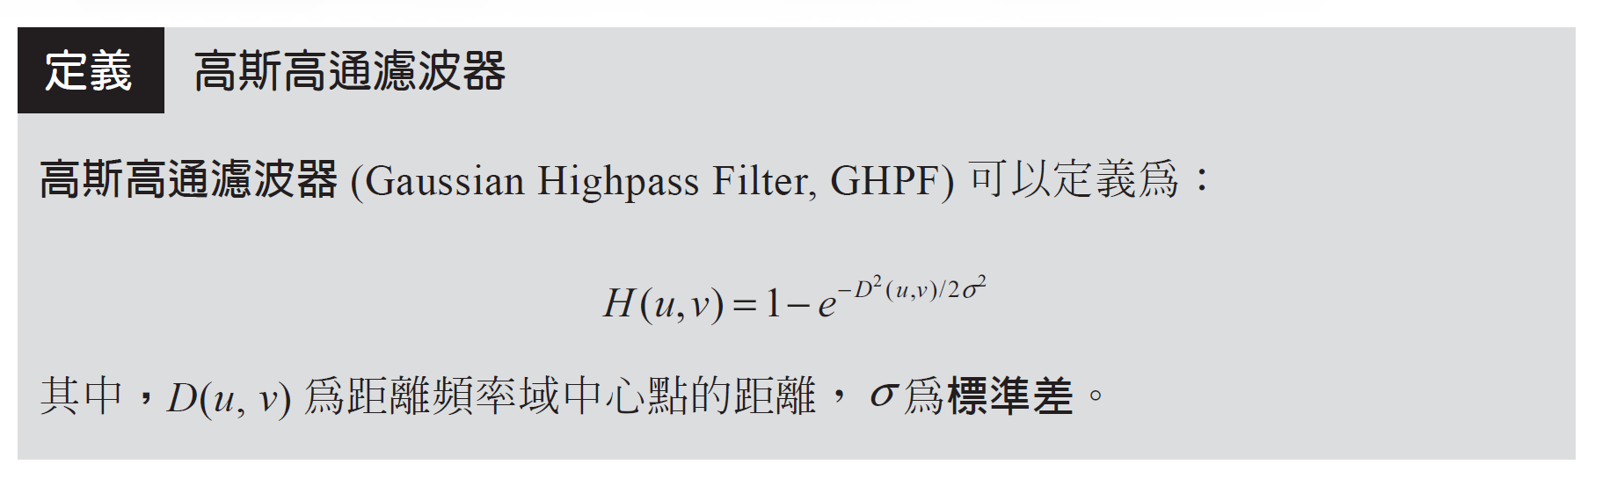

Slide 33
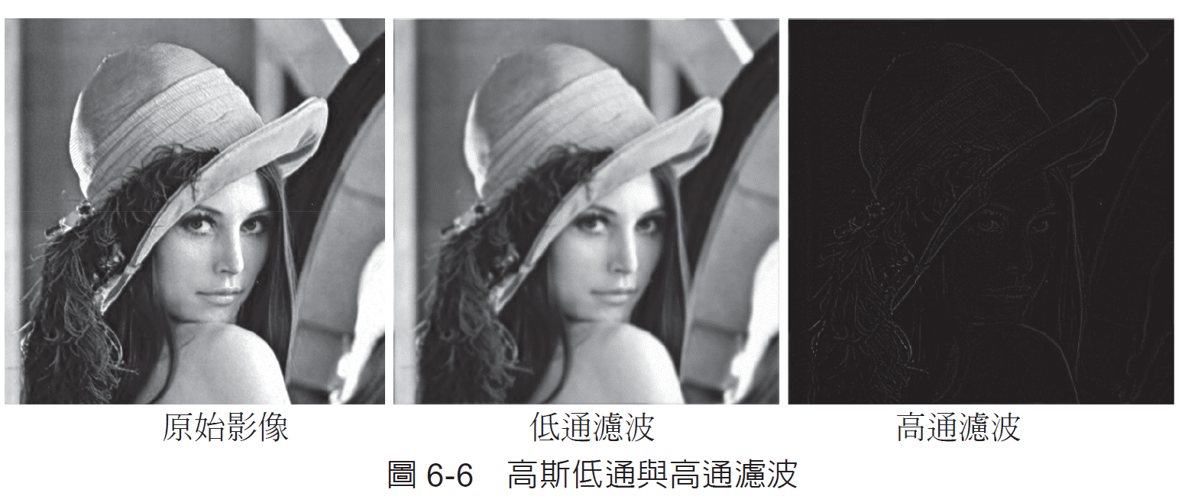

Slide 34
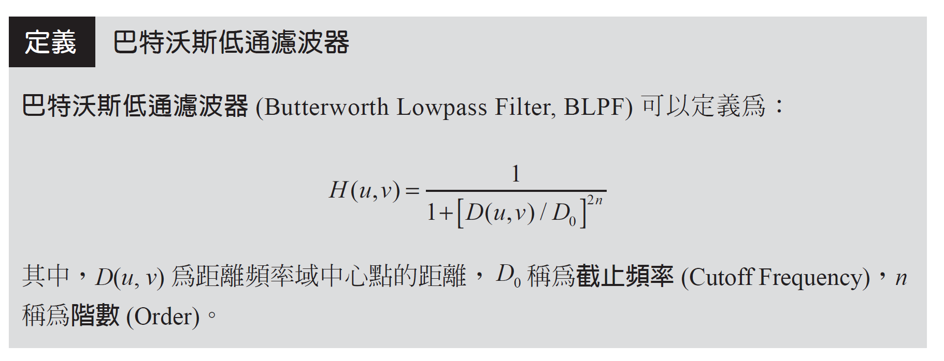

Slide 35
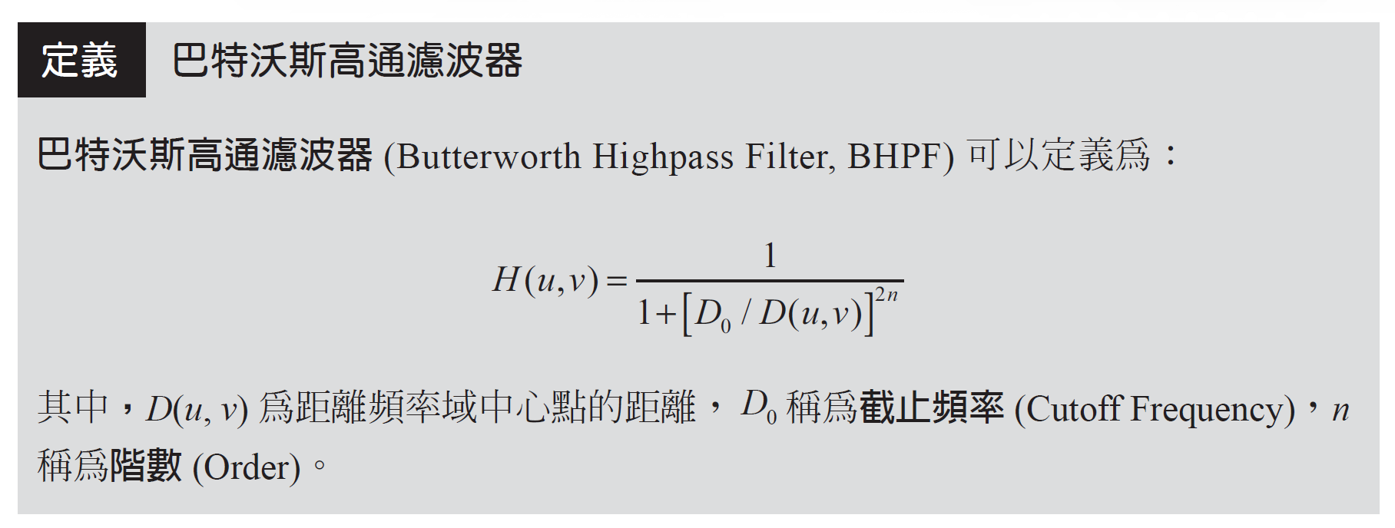
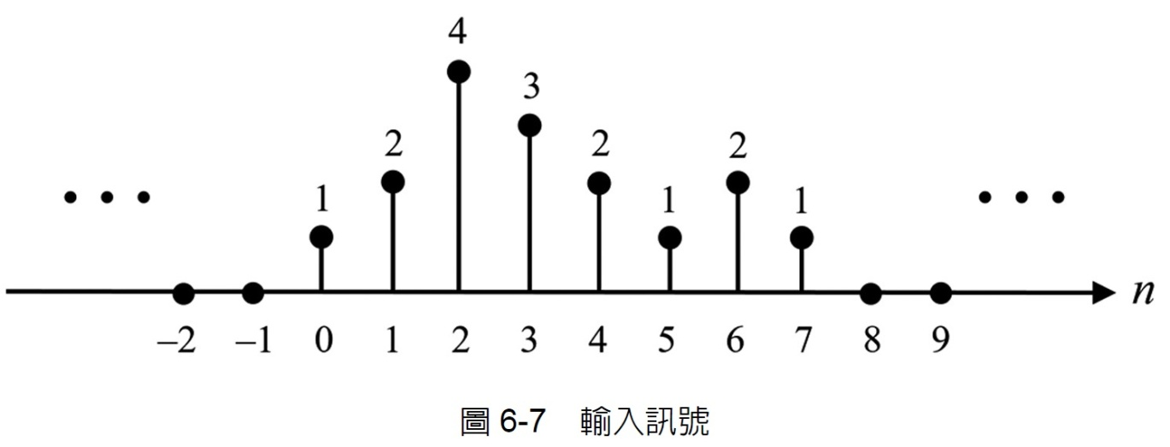

Slide 36
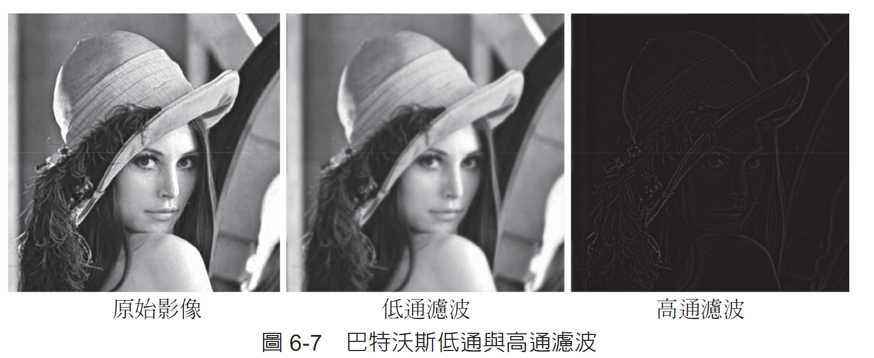

Slide 37
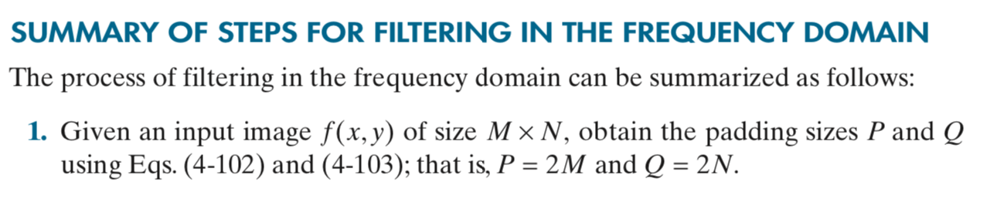

Slide 38
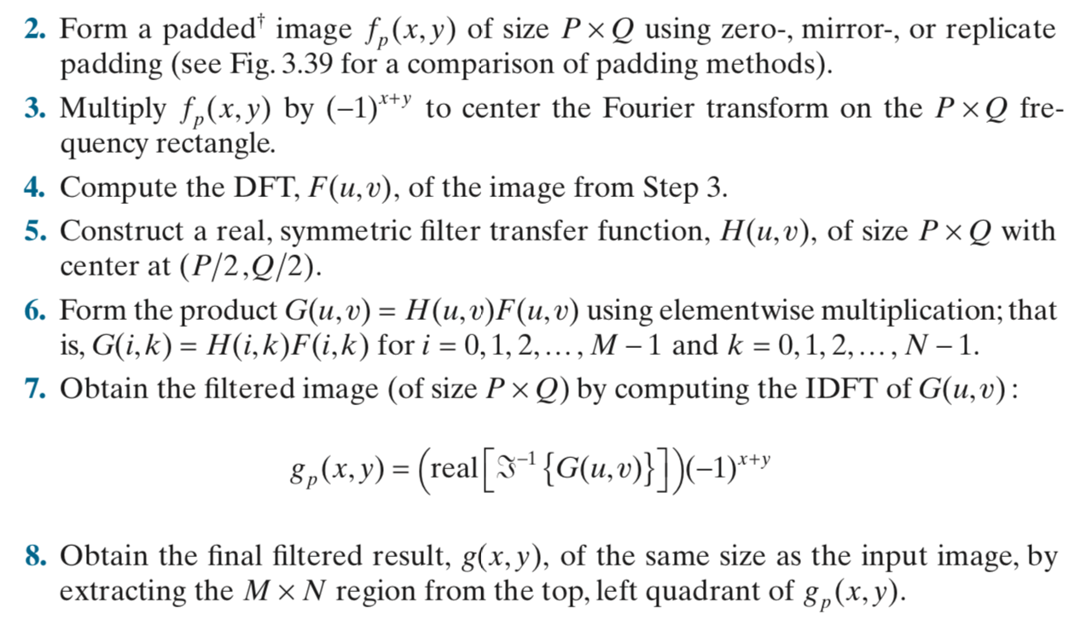

Slide 39
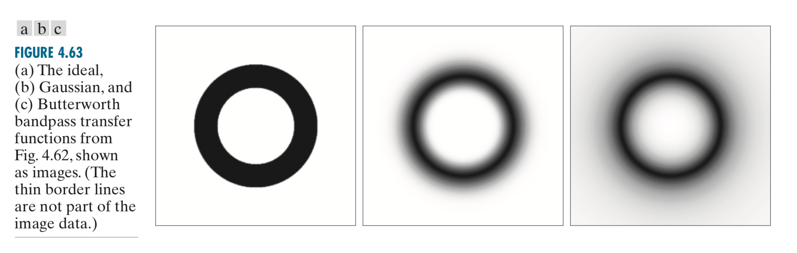

Slide 40
完成 5.3 Frequency Filtering 程式

Slide 41
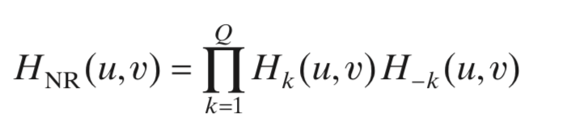
Notch Filter
the most useful of the selective filters
rejects (or passes) frequencies in a predefined neighborhood of the frequency rectangle
be symmetric about the origin
Notch reject filter transfer functions are constructed as products of highpass filter transfer functions whose centers have been translated to the centers of the notches. The general form is:
where H_{k}(u,v) and H_{−k}(u,v) are highpass filter transfer functions whose centers are at (u_{k},v_{k}) and (−u_{k},−v_{k}), respectively

Slide 42
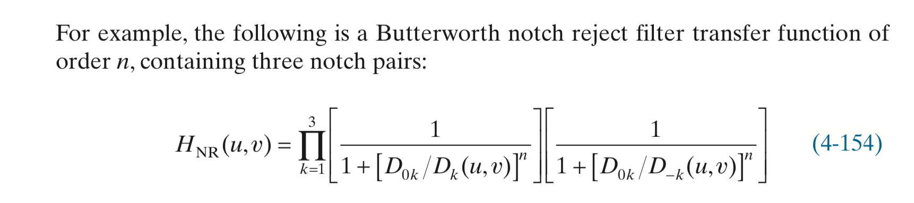

Slide 43
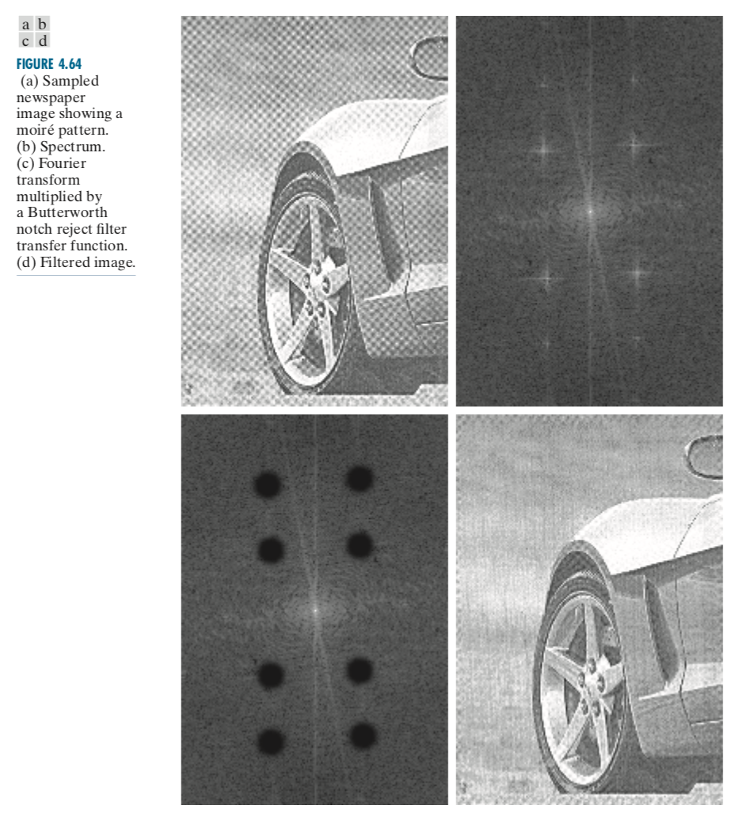

Slide 44
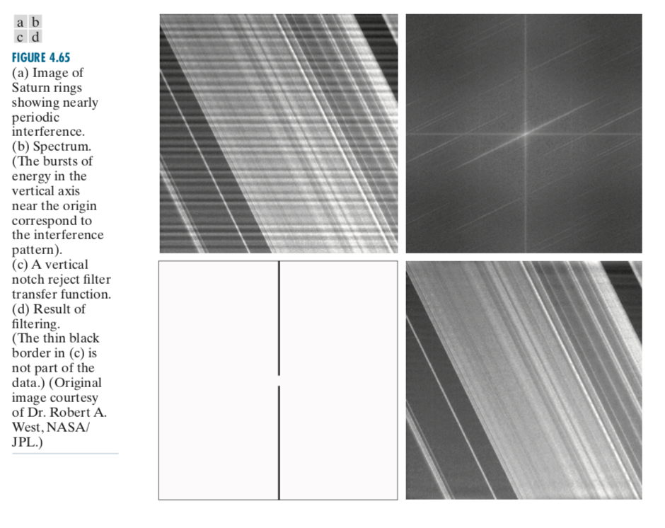
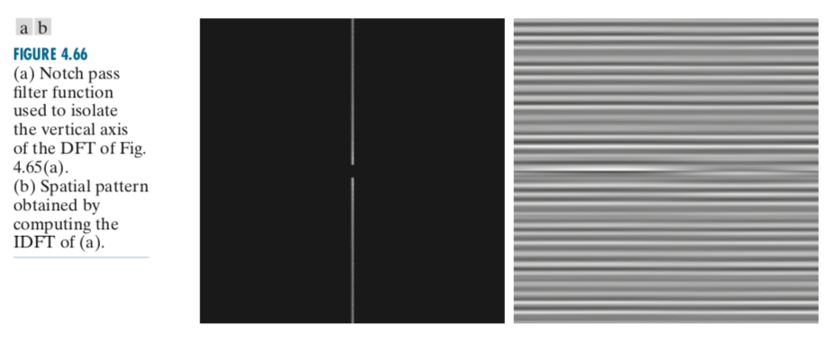

Slide 45
完成 5.4 Notch Filter 程式

